Slide 1

Rittman Analytics
INTRODUCTION
Analytics consultancy founded in 2018 by Mark Rittman
Based in Brighton, UK with clients in UK, EU and USA
Google Cloud Specialised Data Analytics Partner
Team of 10 Certified Google Cloud consultants
Specialists in Looker, BigQuery GCP stack
  5+ Years partnering with Looker, Google Cloud
  Cube, Fivetran, Dagster
  dbt Labs, Snowflake, Oracle
  Segment, Rudderstack, SnowCatCloud
We help high-growth data-rich businesses
  Define their data strategy
  Modernise their data stack
  Centralise their reporting data
  Scale their approach to data analytics

Slide 2
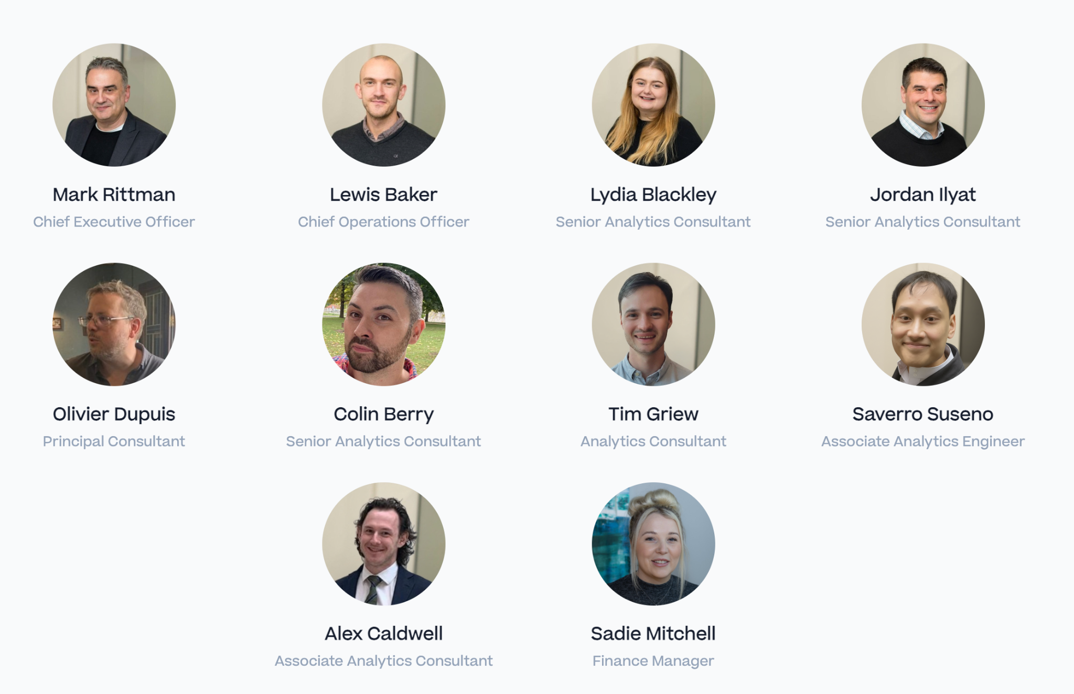
Our Team of Experts
Our team is composed of seasoned data strategists, architects, and analytics engineers with decades of combined experience.

Slide 3
Project Timeline
INTRODUCTION
Sprint # 1 : Understand requirements, evaluate BI tool options
Sprint # 3 : Refinements and evaluation of Power BI features
Sprint # 5 : Technical architecture and creation of second semantic model
Oct 2023
Aug 2023
Sep 2023
Nov 2023
Sprint # 2 : Data modeling and initial semantic model build
Sprint # 4 : Mestec Testing and Evaluation

Slide 4
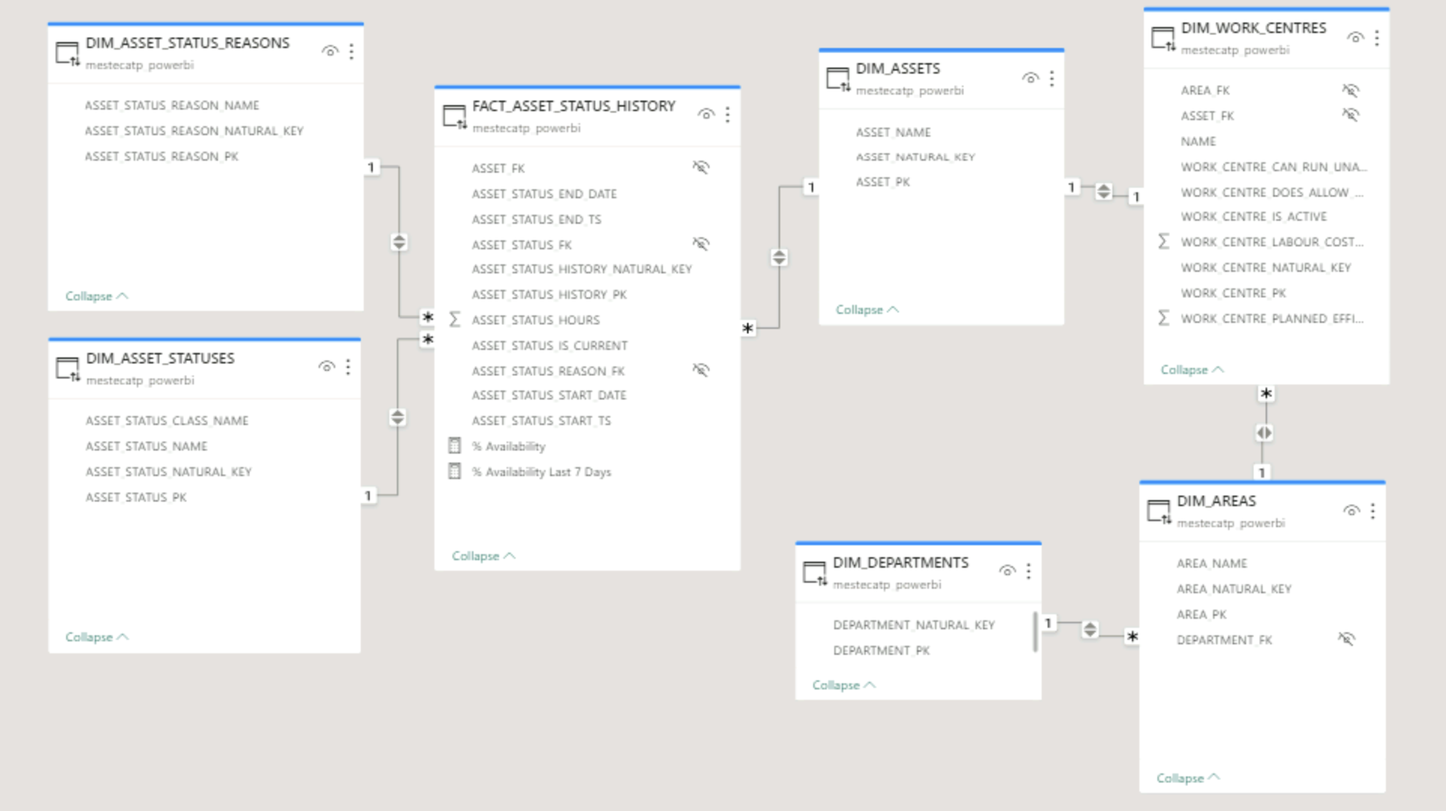
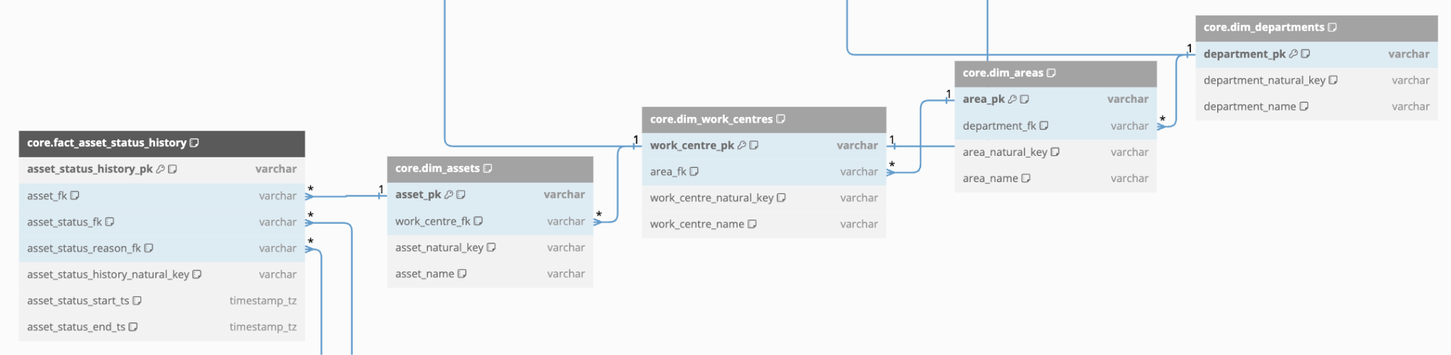
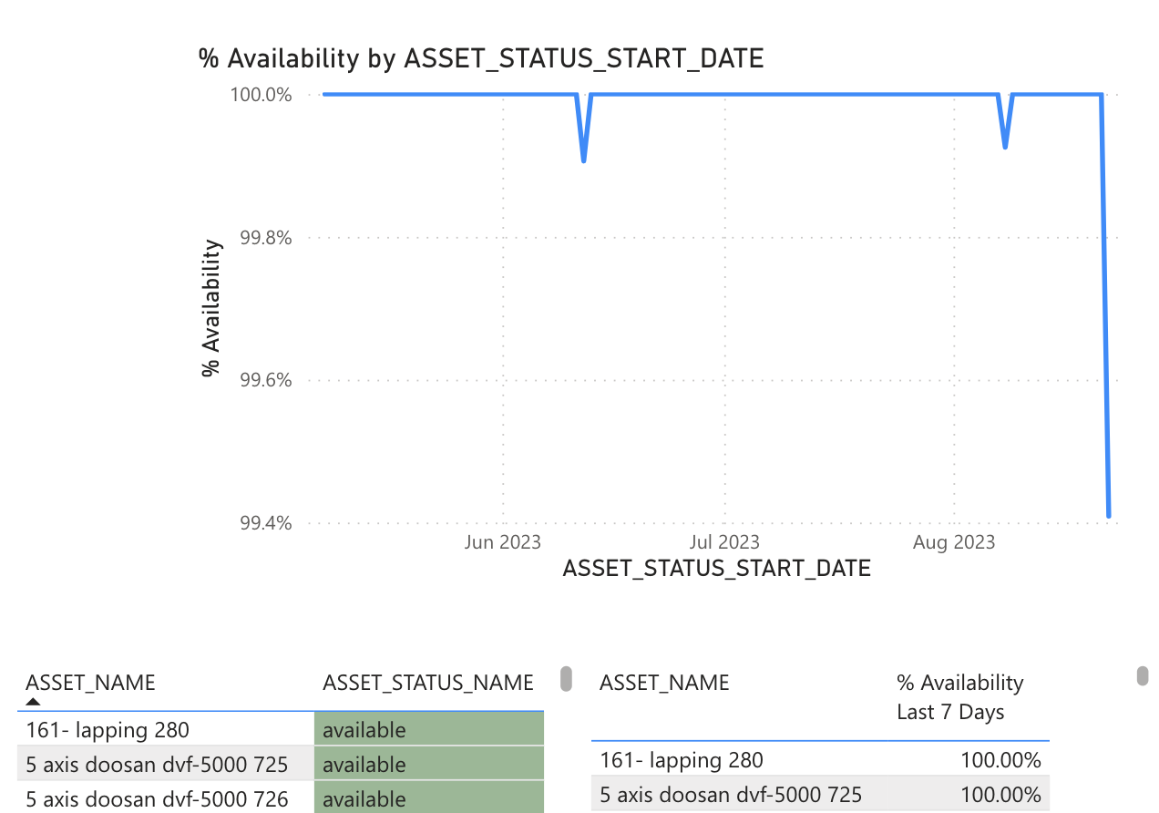
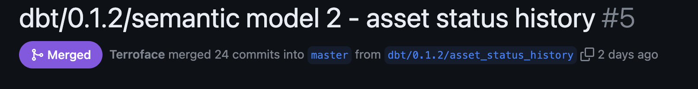
Second Semantic Model
Multiple analytics subject areas
Semantic model
Design
1
3
dbt
2
4
Test output

Slide 5
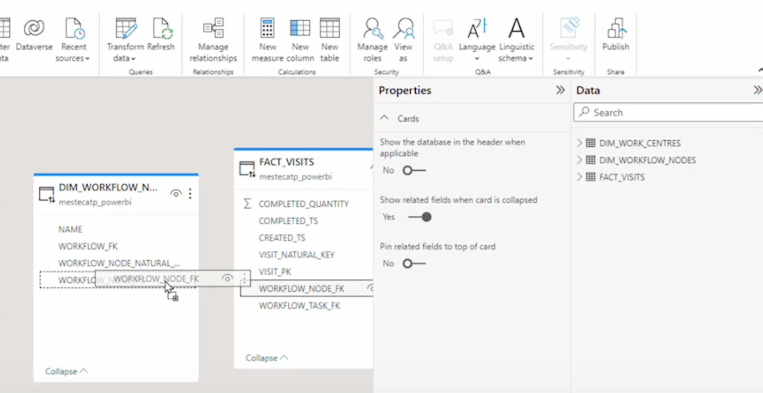
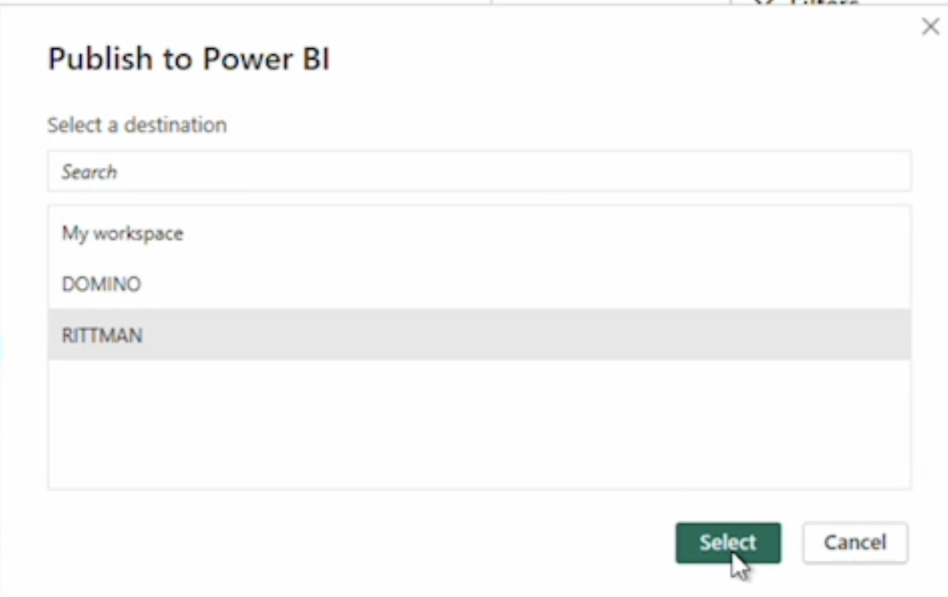
Desktop: Creating Semantic Models
Demo highlight
Join tables, creating aliases for dimensions used multiple times
1
2
Publish to Power BI Server
Import table / MV metadata and create based model
3

Slide 6
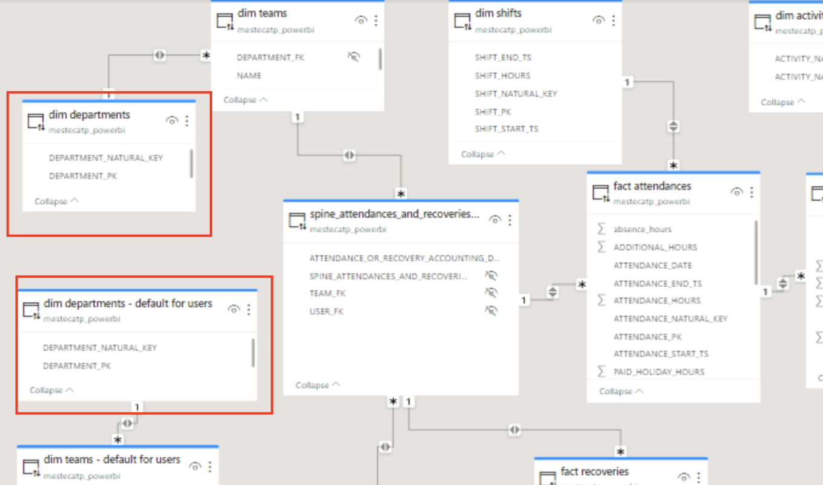
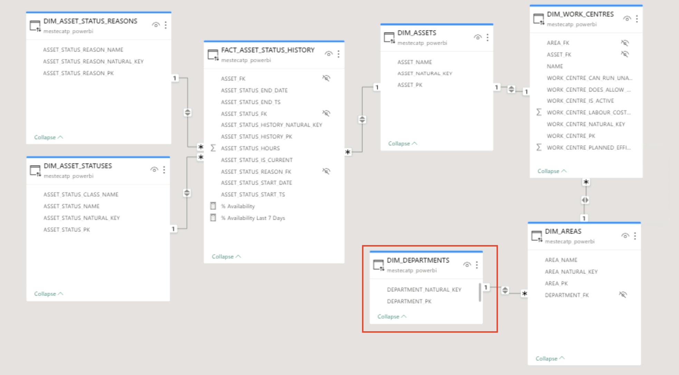
Creating Reports from multiple semantic models
Demo highlight
Re-use of conformed dimensions

Slide 7








Route to Initial Pilot with 2 Semantic Models
Product development
RA / PoC Team
Tasks
Clear technical debt
from PoC
Configure to support
multi-tenancy
Implement scheduler & run-time environment
Mestec Customer Team Tasks
Identify Pilot customers
Run enablement workshop
Roll-out to Pilot customers
Mestec IT Team Tasks
Update Upgrade processes
Enable Mestec IT Team
Create devops processes

Slide 8
Mestec Upgrades and Impact on Semantic Models
Architecture
Before Upgrade
After Upgrade
Mestec Environment
All Customers get the same application code for a given release version
Mestec Environment
Custom reports are not updated or deleted during upgrade (with Mestec responsible for updating them to maintain version compatibility, or the customer?
Application Code v10.1
Application Code v10.2
Standard workspace reports and data models replaced with versions compatible with app version
PBI Workspace
metrics_report.pbix
data_model.pbix
PBI Workspace
metrics_report.pbix
Data_model.pbix
custom_report

Slide 9
Future BI product development
Product development
Tasks / Visits
As part of the regular release cycle, we would aim to make changes or additions to the BI product.
The best way to do this would be treating is as a software product. Over a set interval of time, releases are developed, tested and then published. The focus of each release will be around a theme e.g. subject area or performance improvements, etc.
The priority and timeline here is illustrative; priorities to be clarified through requirements gathering
Month n
Task: The journey of a material item through a workflow
Visit: Material item’s visit to a node in a workflow.
Performed Activities
Month n+1
This table was joined into the attendances and recoveries model, but it hasn’t been properly considered / designed on its own
Month n+2
User History
Including the default team for the user at the time of the fact record rather than using the most recent value.
Performance Optimization
Month n+3
Decreasing query response time

Slide 10
Recommended Team Structure going Forward
OPPORTUNITIES AND NEEDS
RA Resource
Product Manager
Product vision
Ownership
Liaison with Customer team
Mestec Resource
Ensuring delivery velocity
Ensuring on time delivery
Technical Lead
Technical leadership for delivery
Technical architecture and design leadership
Ensuring on time delivery
Project Manager
Train-the-trainer for Mestec
Domain expertise
Business Analyst
Analytics Engineer
Providing clean, transformed data ready for analysis using SQL, dbt and off-the-shelf data pipelines

Slide 11
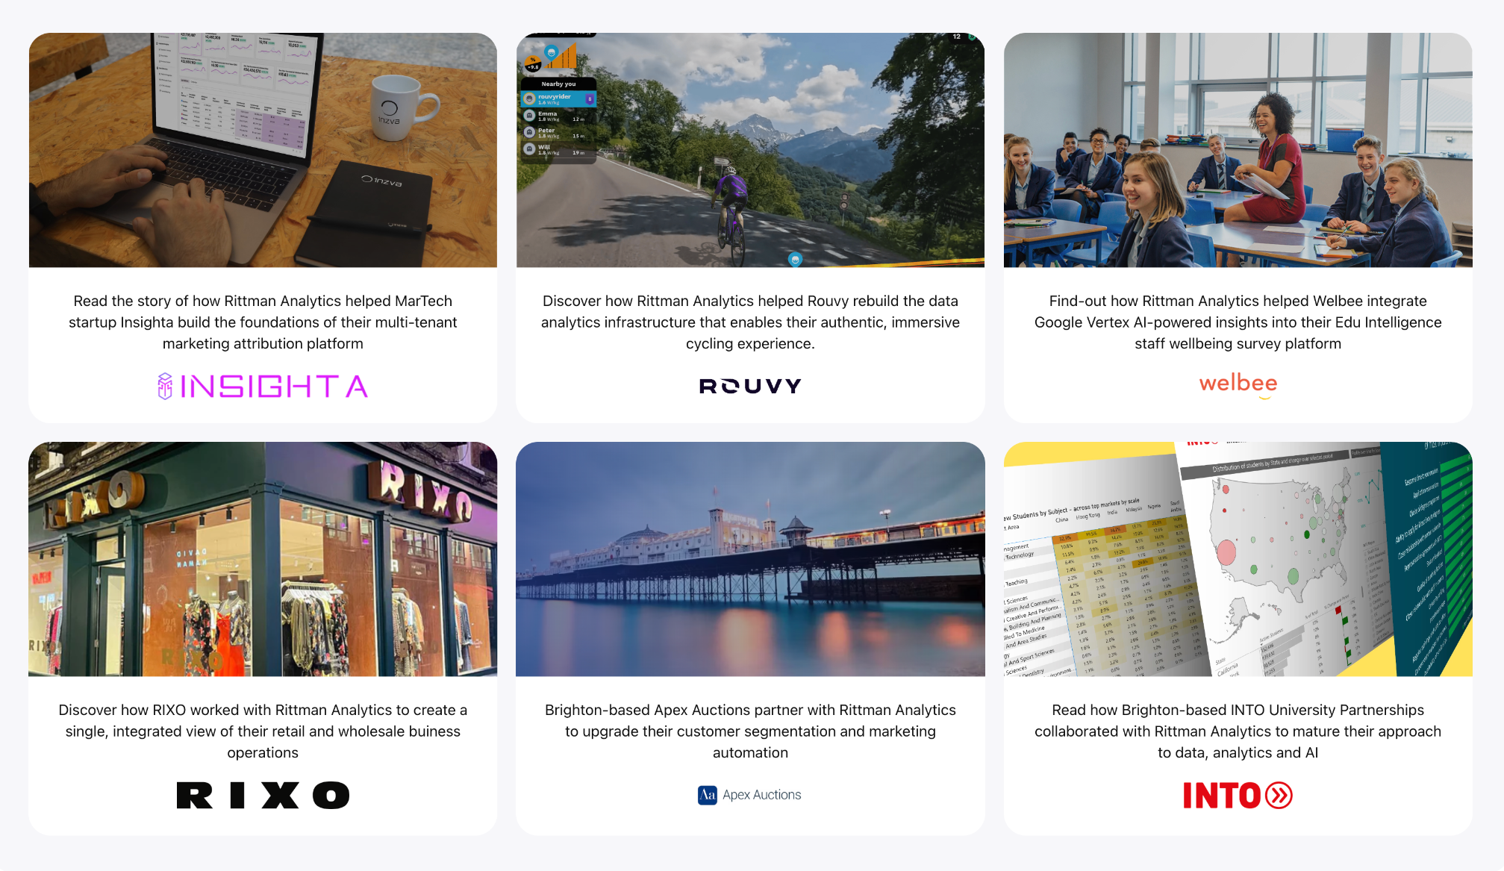
Working with Clients in the UK, EU, USA (and BN1!)

Slide 12

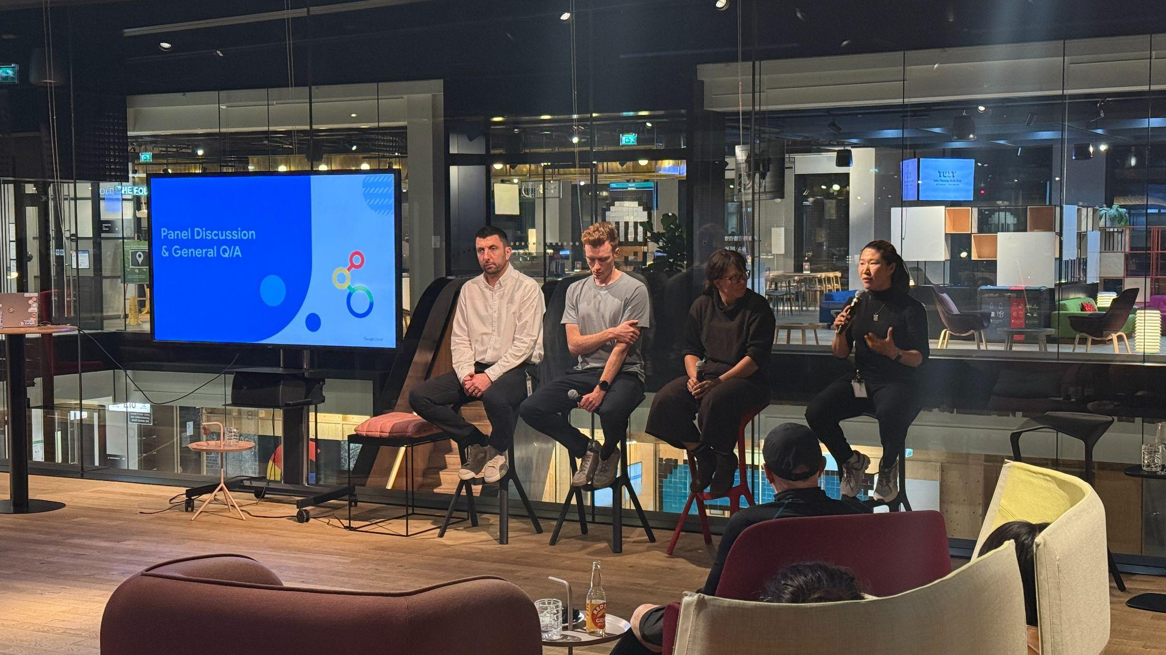
Long-Term Supporters & Presenters at BDF
Sponsors and Organisers of the London Looker Meetup

Slide 13

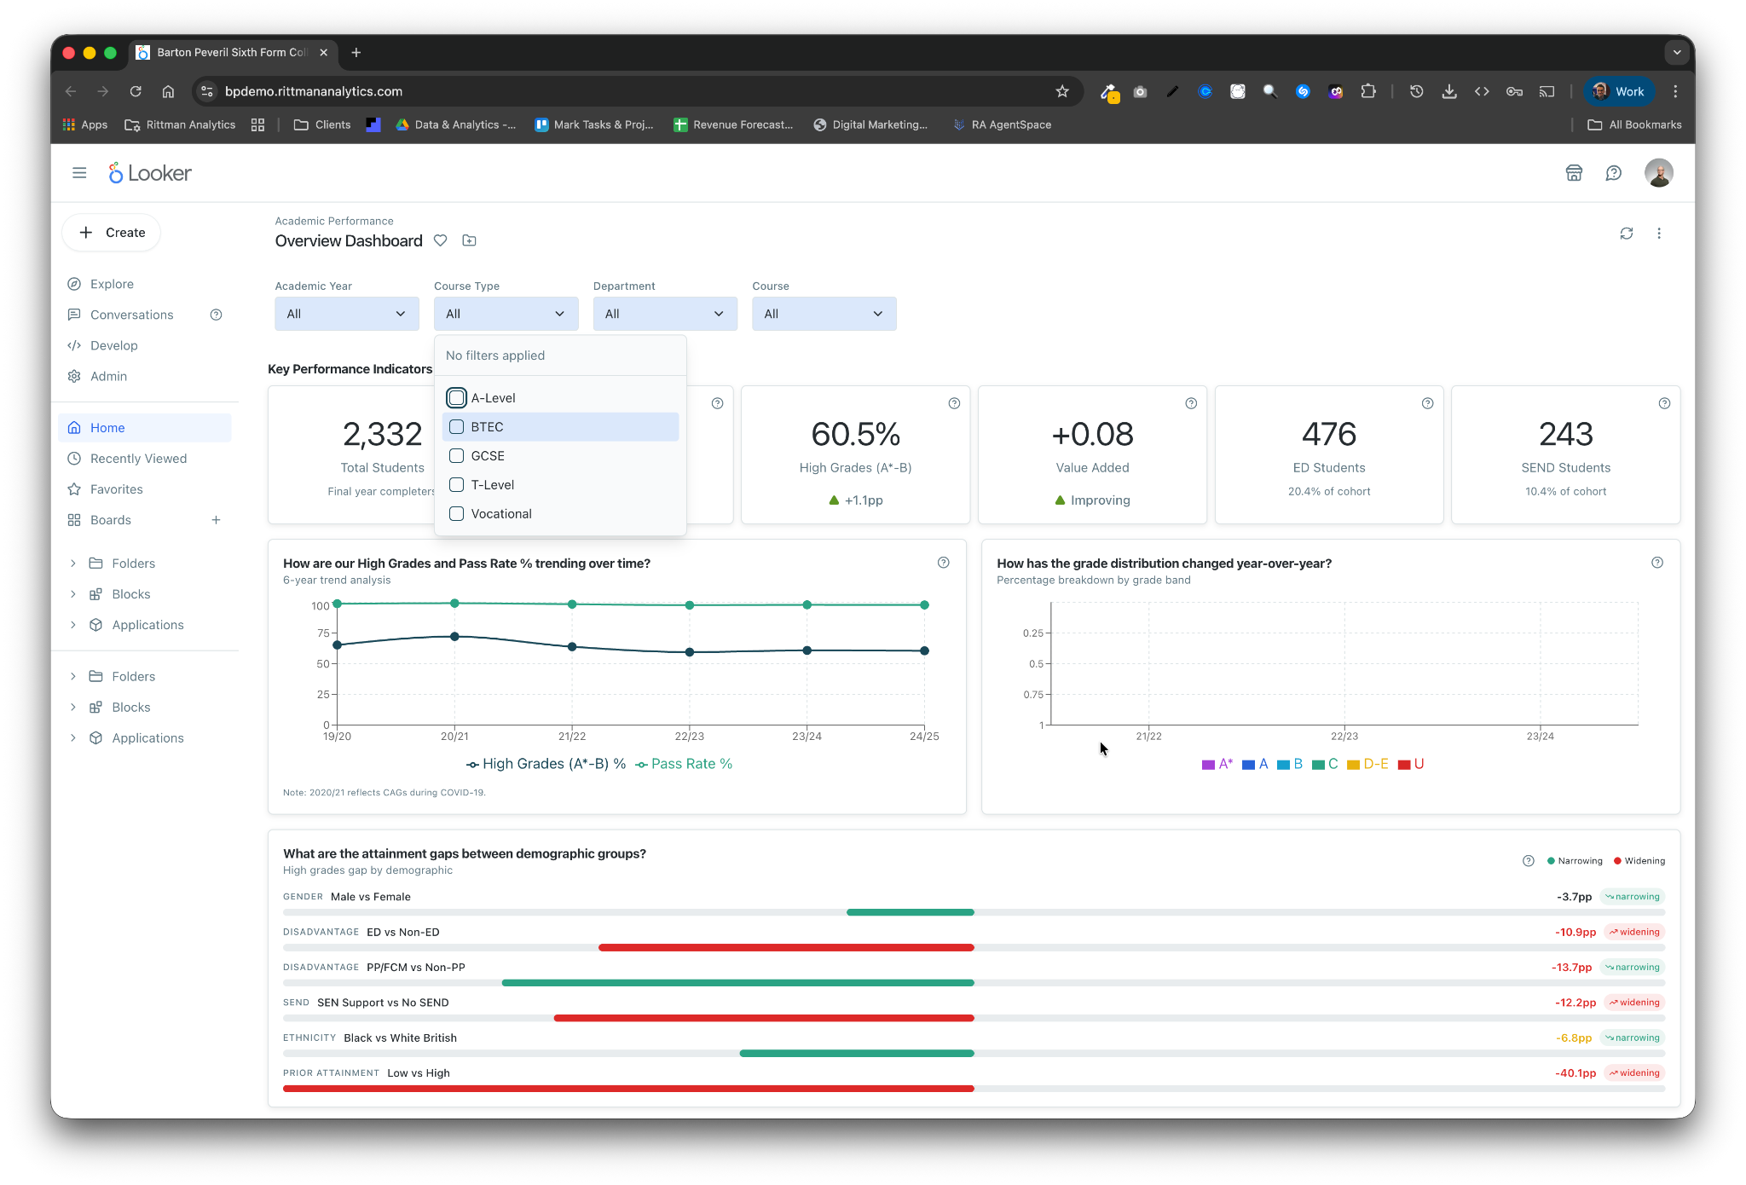




What We Are Building
INTRODUCTIONS
The primary goal of this platform is to empower a range of stakeholders, including:
  Directors & Subject Leaders
  Senior Leadership Team
  ALPS & 6 Dimensions Specialists
  MIS Team
to interrogate this consolidated
Barton Peveril dataset, using
  Interactive dashboards
  Published reports
  Ad-hoc queries
  Conversational analytics

Slide 14
Discovery Workshop
DISCOVERY
We want to hear from you about the questions you can't easily answer today:
We're particularly interested in:
  Pain points with how you currently get data and reports
  What insights you wish you had access to
  Which questions matter most to your day-to-day work
  Simple priority ranking exercise to understand what's most valuable
For example:
  Understanding subject performance trends and anomalies
  Identifying where students are underperforming within your subjects
  Comparing your results to national benchmarks
  Spotting attainment gaps by gender, disadvantage, ethnicity, or SEND
  Understanding grade distributions and how they're changing

Slide 15
Interactive Dashboard Mocks @
https://bpdemo.rittmananalytics.com (full concepts)
https://bpdemo-mvp.rittmananalytics.com (MVP data only)

Slide 16
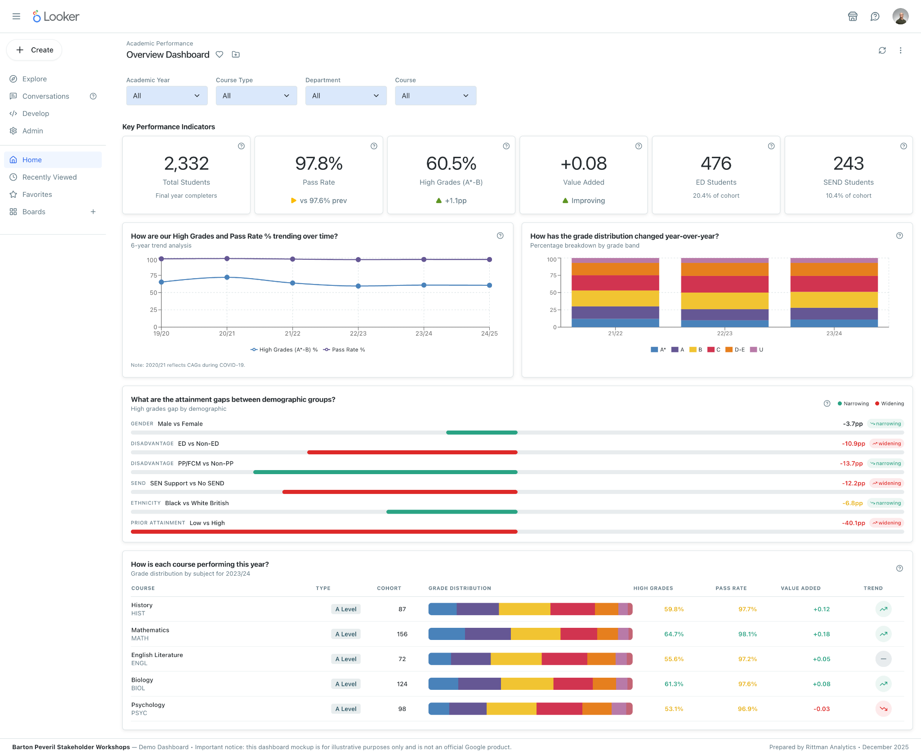
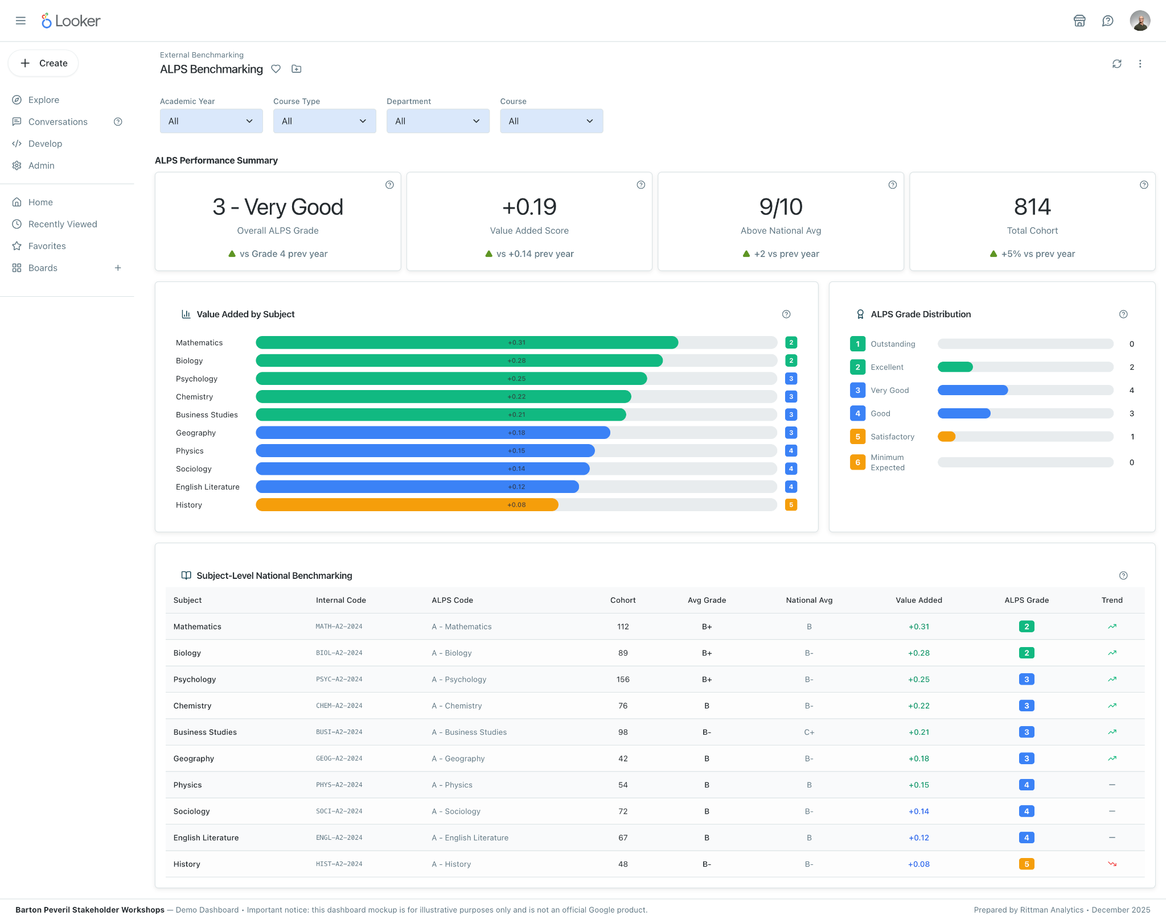
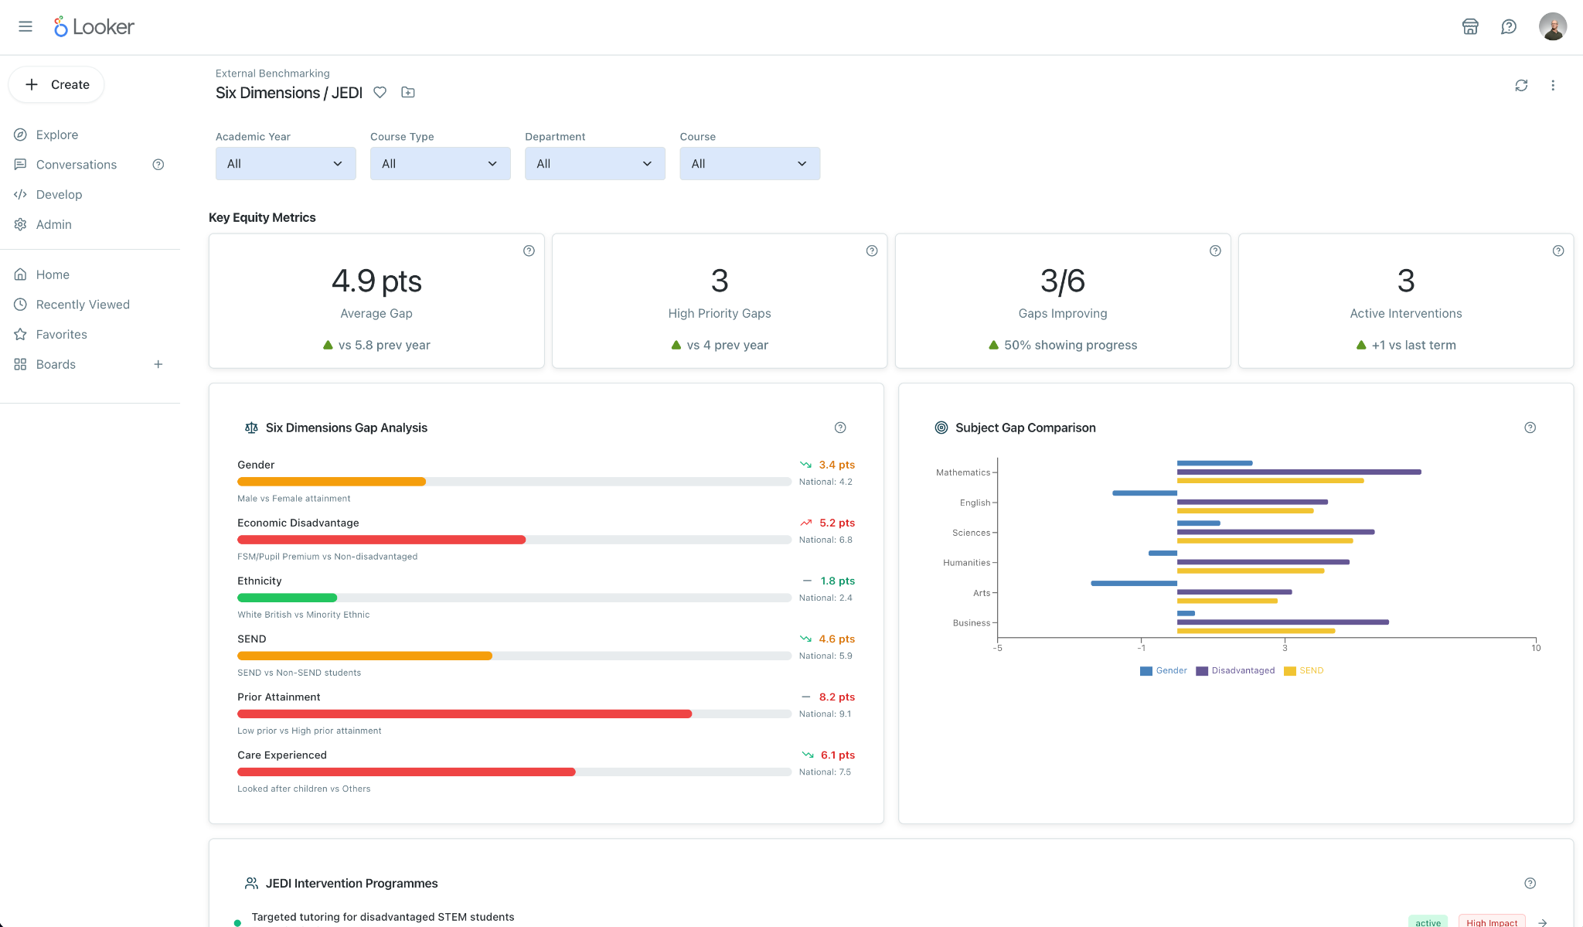
Project Timeline
WRAP-UP
Dec 1st 2025
Dec 19th 2025
Week 1:
MVP: Core Student Attainment
Week 2:
ALPS Provider Benchmarking
Week 2:
Six Dimensions/JEDI Benchmarking Integration

